Slide 1
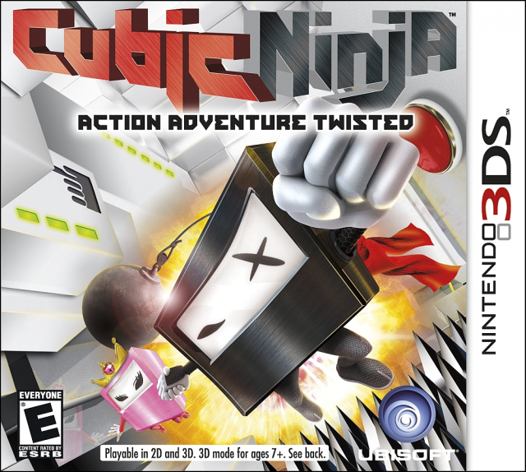
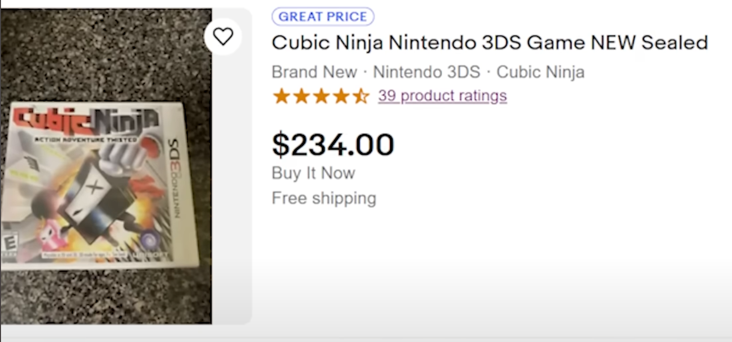
51/100
IGN: "one of those frustrating games that is almost really cool, but never quite delivers"
"an experience that feels like it just as easily could have been a $5 iPhone game"
Notes:
Nintendo 3DS- could share levels via QR code scanning
Hacker made their own QR code
QR code data was stored on the stack- stack had a buffer overflow

Slide 2

Video Game Hacking
By Eric Pressler

Slide 3
Agenda
Legal & Ethical Disclaimer
Game Hacking I Did
Resources
Example Game Hacks
Why You Should Learn Video Game Hacking

Slide 4

Legal & Ethical Disclaimer

Slide 5

Legal & Ethical Disclaimer
Video game hacking can be HIGHLY ILLEGAL!!!
For online/multiplayer games, hacking can severely ruin the experience for other players
When in doubt, always make sure you have proper authorization before hand
Remember, we are ethical hackers

Slide 6
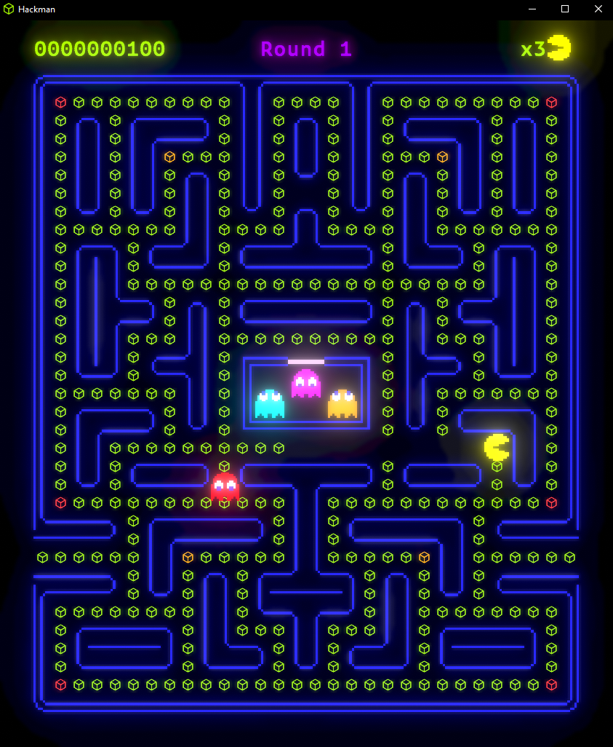

Slide 7
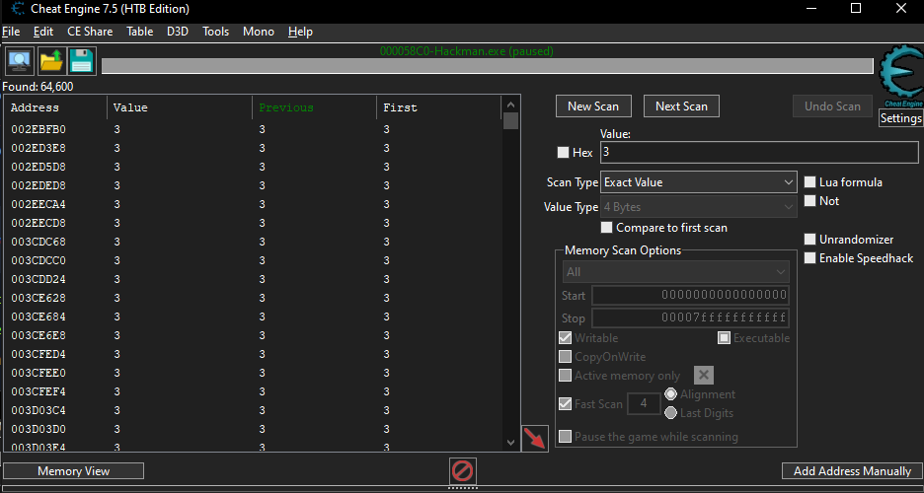

Slide 8

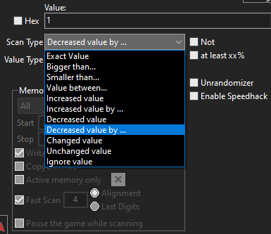

Slide 9
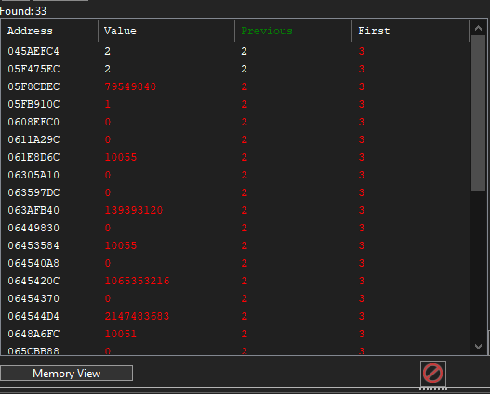
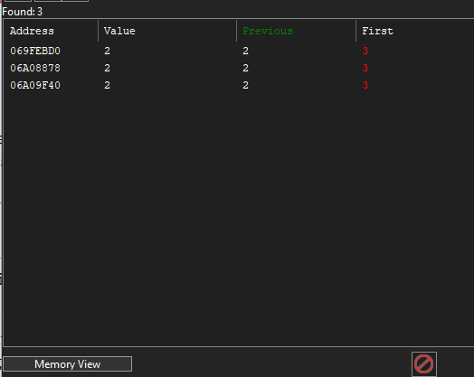

Slide 10
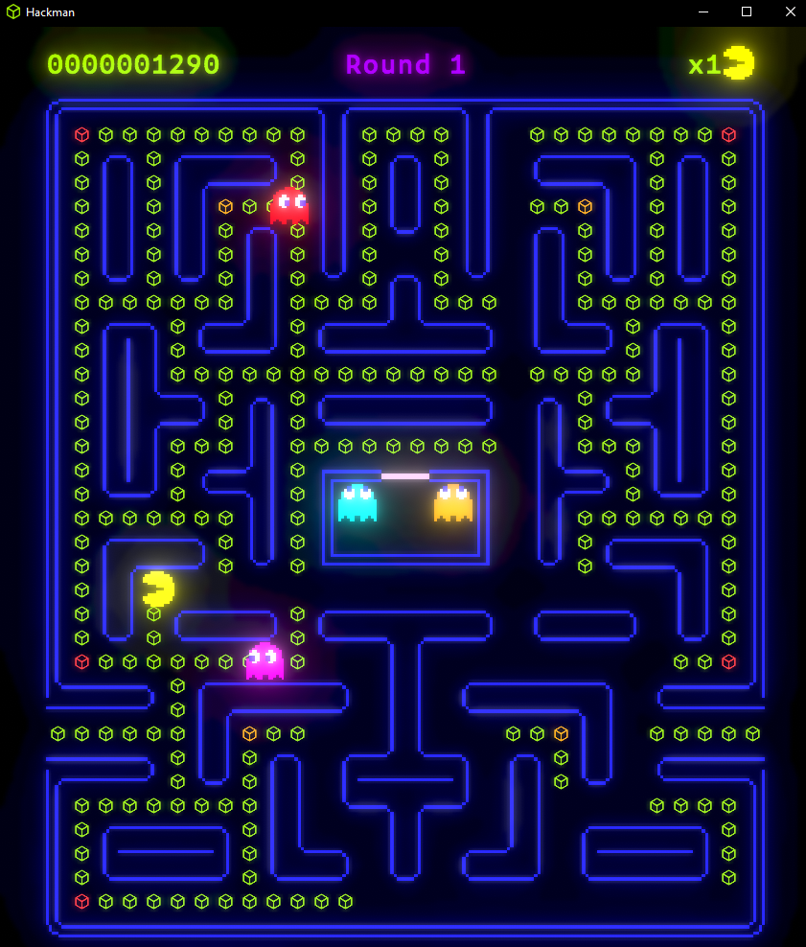
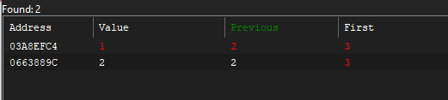

Slide 11
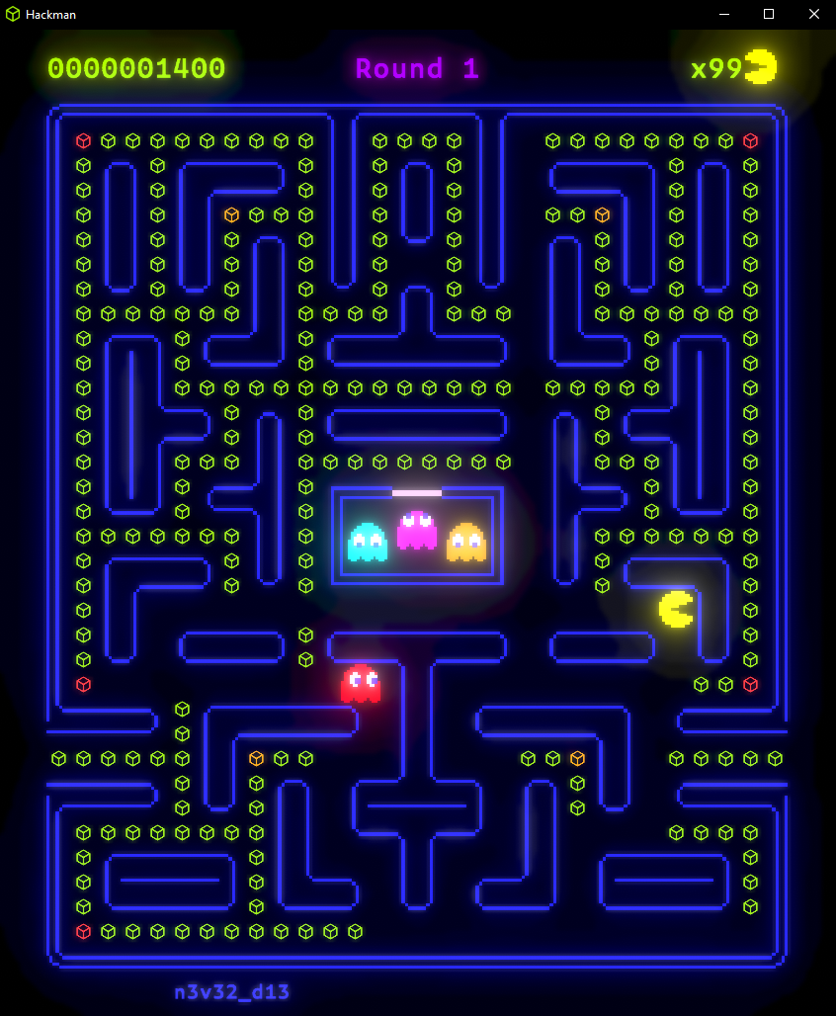
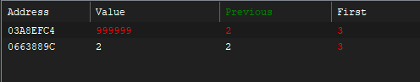

Slide 12
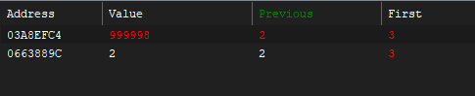

Slide 13
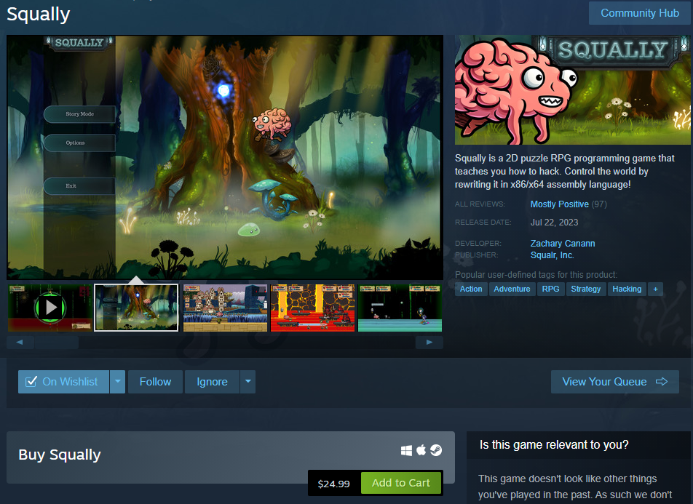

Slide 14


Slide 15


Resources to Learn Game Hacking
Hack the Box Academy

Slide 16
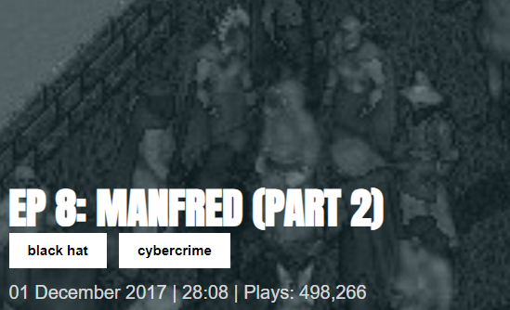
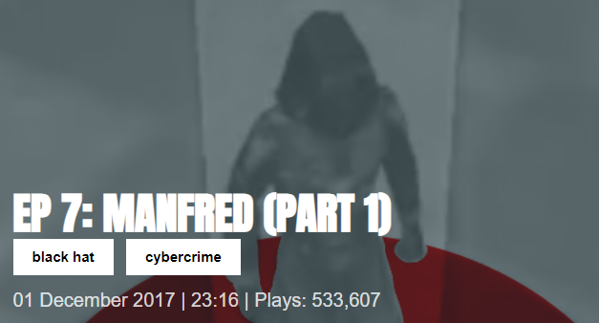
Resources to Learn Game Hacking
Darknet Diaries
Manifred (Part 1)
Manifred (Part 2)

Slide 17
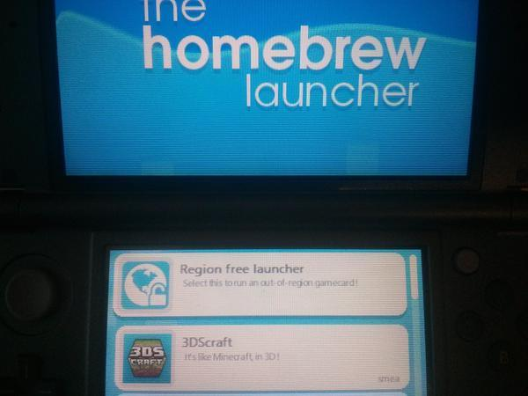
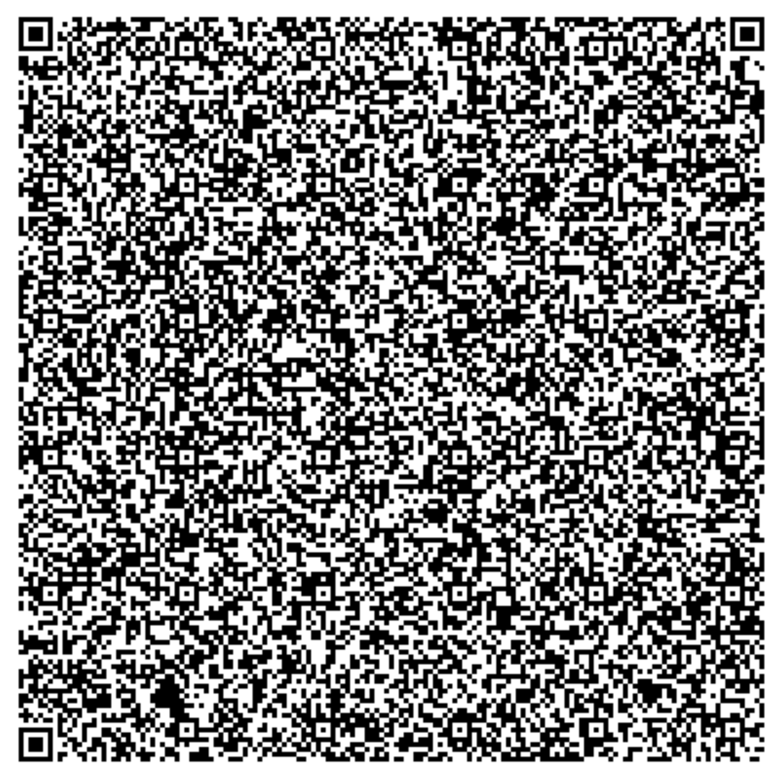
Cubic Ninja
Notes:
Nintendo 3DS- could share levels via QR code scanning
Hacker made their own QR code
QR code data was stored on the stack- stack had a buffer overflow

Slide 18
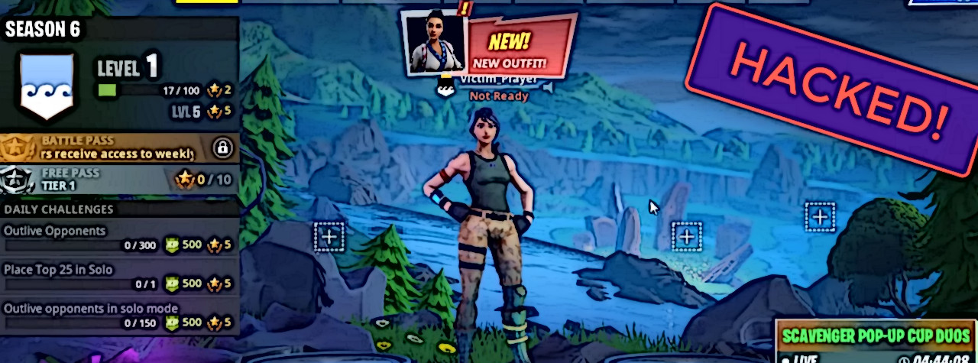
Epic Games Fortnite Hack of 2018

Slide 19
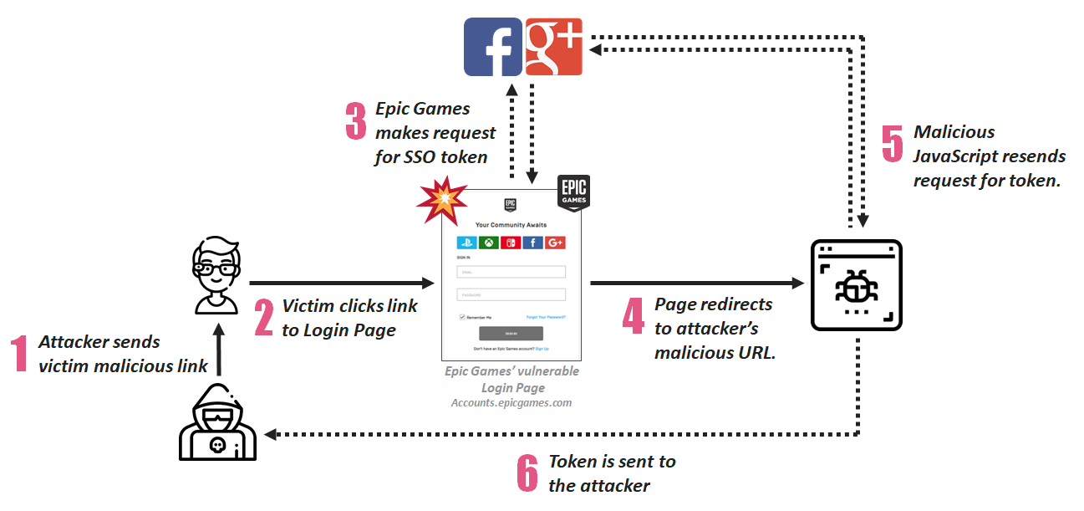
Epic Games Fortnite Hack of 2018
Notes:
XSS to exfiltrate login token

Slide 20
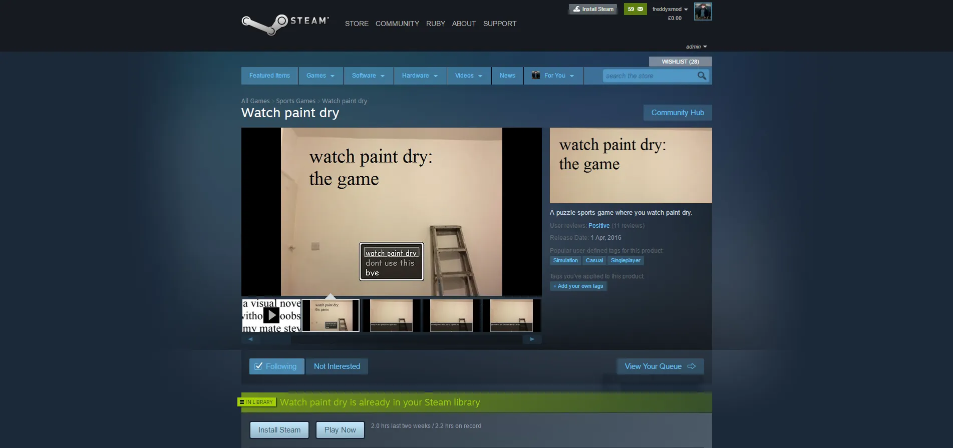
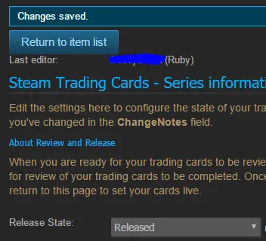
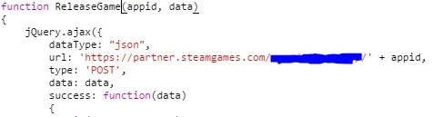
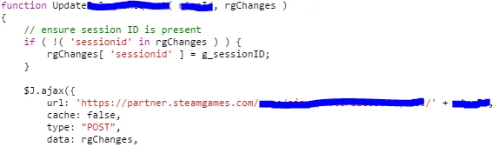
Watch Paint Dry
Notes:
Bypassed all of Steam’s authentication and review process
IDOR vuln lead them to be logged in as a Valve employee
Learned about Reviewed vs Ready to be Reviewed status
Unobfuscated JS ReleaseGame() function

Slide 21
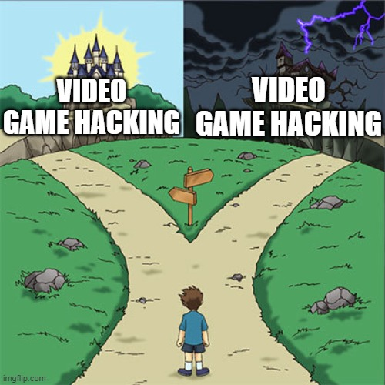
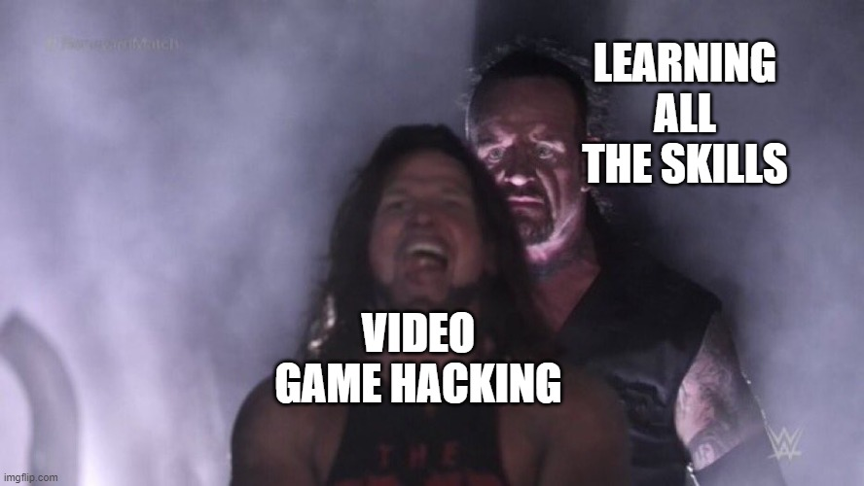

Slide 22
Why You Should Learn Game Hacking!
Skills You Might Need
Assembly Language (especially x86-64)
Reverse Engineering
Networking (packet captures)
Script Writing
PATIENCE AND PERSEVERANCE!!!
“The biggest problem we see is people focusing on the result (the hack) and not the journey (learning).” -Guided Hacking

Slide 23
Sources
Background image by Freepik
Cubic Ninja Wikipedia
Cubic Ninja 3DS Hack
Ninjhax QR Code Generator
Warning Sign Image
White Hat Hacker Image
Watch Paint Dry Steam Hack
Epic Games Fortnite Hack of 2018
Squally on Steam
Game Hacking YouTube Course
Manifred (Part 1) - Darknet Diaries
Manifred (Part 2) - Darknet Diaries

